Slide 1
Pr Emmanuel Chazard
version du 9 août 2020
Ce fichier est destiné à vous aider :
il est fourni sans aucune garantie
vous seul êtes responsable de sa bonne utilisation
si son contenu est corrompu, téléchargez une version propre
consultez la vidéo d'explication sur https://www.youtube.com/watch?v=yGxDV22NSTQ
Voyez l'ensemble du cursus (cours, fichiers prêts à l'emploi, vidéos) sur http://emmanuel.chazard.org/theses.htm

Slide 2
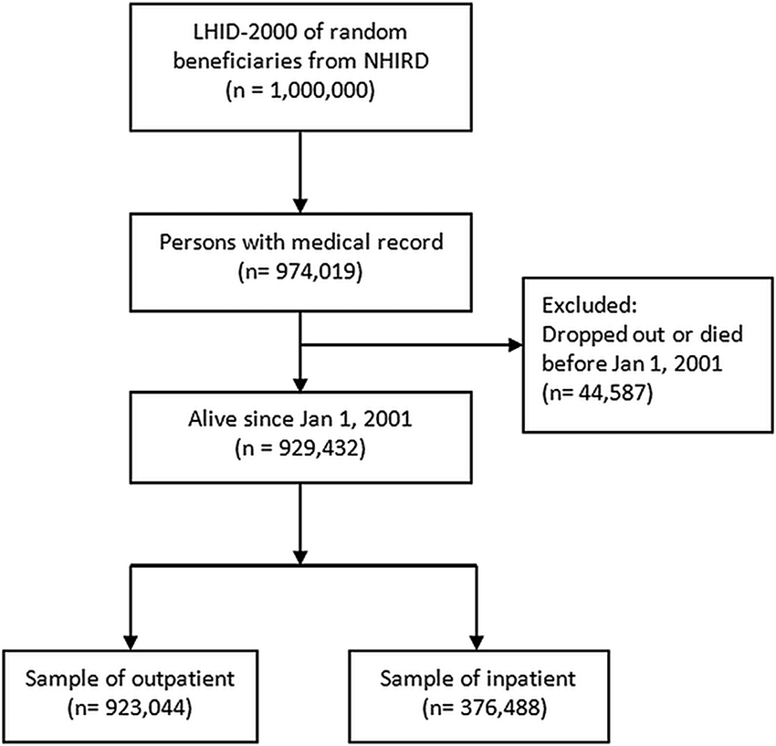
Chang Gung Research Database: A multi-institutional database consisting of original medical records. Ming-Shao Tsai, Meng-Hung Lin, Chuan-Pin Lee, Yao-Hsu Yang, Wen-Cheng Chen, Geng-He Chang, Yao-Te Tsai, Pau-Chung Chen, Ying-Huang Tsai. Biomed J. 2017 Oct;40(5):263-269. doi: 10.1016/j.bj.2017.08.002. Epub 2017 Nov 10.
Exemple de flowchart portant sur des personnes physiques

Slide 3
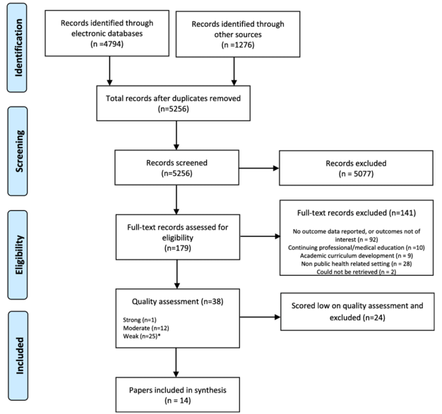
Effectiveness of capacity building interventions relevant to public health practice: a systematic review
Kara DeCorby-Watson, Gloria Mensah, Kim Bergeron, Samiya Abdi, Benjamin Rempel, Heather Manson
BMC Public Health. 2018 Jun 1;18(1):684. doi: 10.1186/s12889-018-5591-6.
Exemple de flowchart portant sur des articles scientifiques

Slide 4
PubMed database search
Example of documents
330 papers
Example of database
Example of process
Title and abstract human reading
94 excluded papers
236 papers
Full-text papers retrieval
18 papers not found
18 papers not directly related to healthcare
3 papers in which big data was not the topic of the paper
1 paper where big data appeared only in the author affiliation, but not in the abstract, nor in the body of the paper
218 papers
Full-text reading
22 excluded papers
196 included papers
Exemple de flowchart réutilisable
Papers classification
48 papers describing a dataset
121 dissertations
27 reviews of literature
Toward a Literature-Driven Definition of Big Data in Healthcare. Emilie Baro, Samuel Degoul, Régis Beuscart, Emmanuel Chazard. Review Biomed Res Int. 2015;2015:639021. doi: 10.1155/2015/639021. Epub 2015 Jun 2.

